Slide 1
SOC Audit Architect
Automation for Sentinel Analytics Auditing.
Find the repository here:
https://github.com/JamesHowardEGM/SOC-Audit-Architect/tree/main

Slide 2
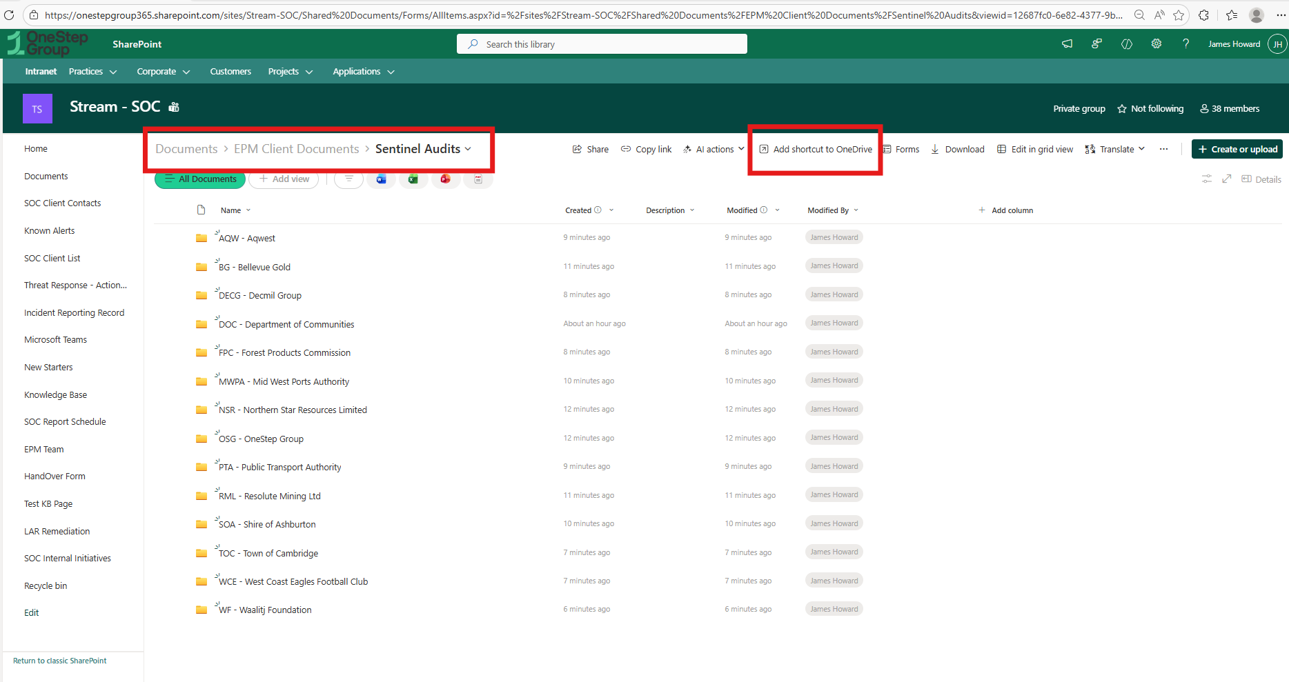
Step 1: Initialize the Environment
The user establishes a shortcut to the OneDrive that the SOC shares.
Note: The script will ask if you have done this.

Slide 3
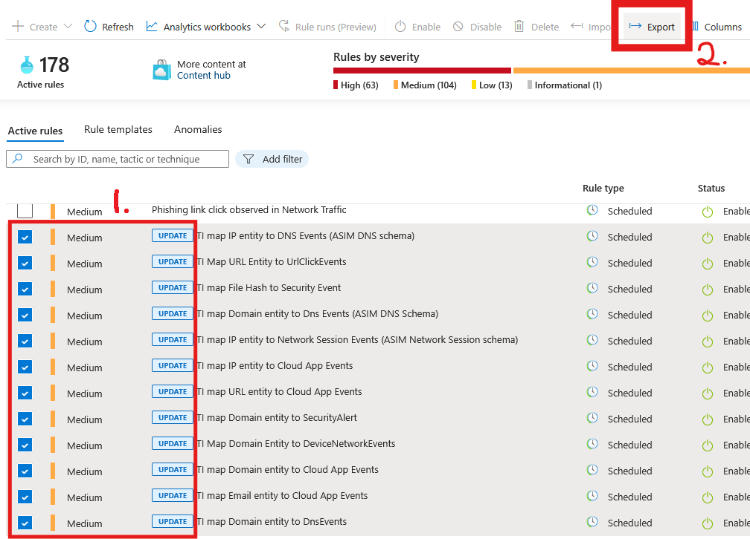
Step 2: Download Master JSON from Sentinel
1. Select the rules you want to audit.
2. Export them;
a JSON file will automatically download into your “Downloads” folder

Slide 4
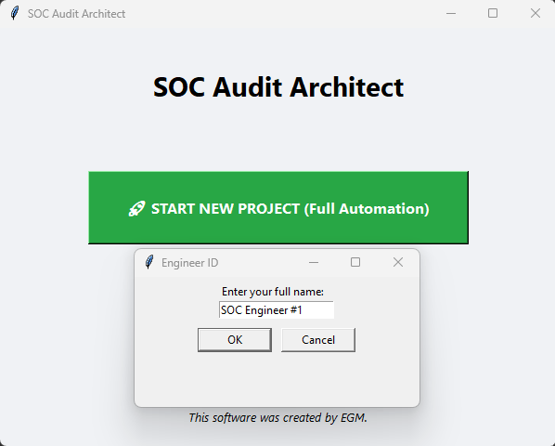
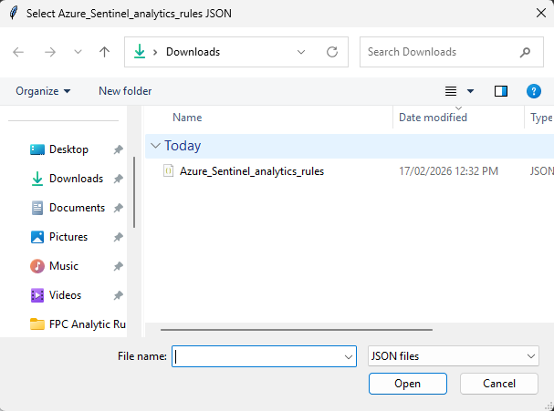
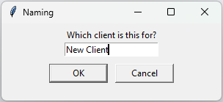
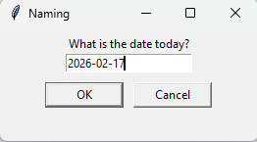
Step 3: Run SOC-Audit-Architect
After clicking start new project;
Enter your full name.
Select the JSON file you downloaded from Sentinel
Name the Client
Confirm the date (it’s automatic)

Slide 5
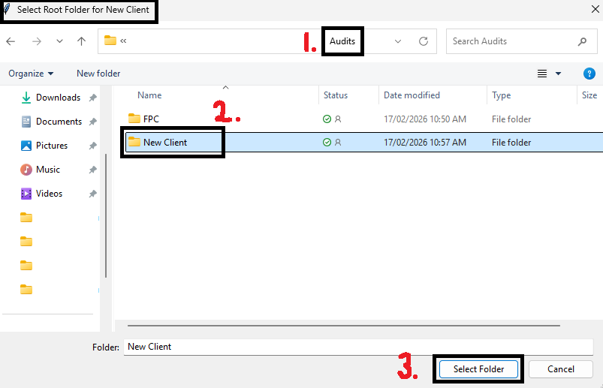
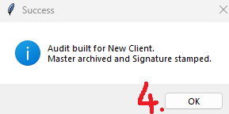
Step 4: Selecting the Root directory for the client (see step 1)
1. Go to your Root Audits folder
2. Select the Client you’re auditing
3. Confirm the client by clicking “Select Folder”
4. Confirm that the Automation is successful, and click “OK”

Slide 6
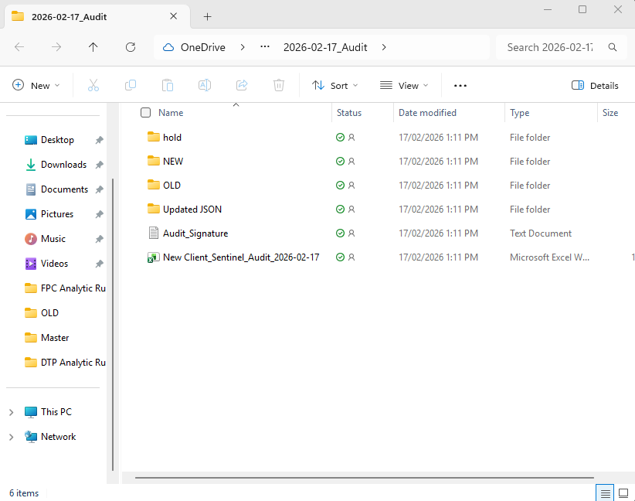
Step 5: Understanding Automated Directories
Upon completing Step 4; The Audit Directory will automatically open, and you will see something like this:
📁 OLD/
JSON files containing the pre-update versions of the rules.
📁 NEW/
JSON files containing the updated versions of the rules.
📁 hold/
Rules that still require automation or testing before they can be finalized.
📁 Updated Json/
Folder used to send updated rule files through DevOps for deployment.
📄 Analytics Rules Table (Excel Document)
Research, analysis, and findings related to analytics rules.
📄 Audit Signature
A simple document recording who is making the audit file

Slide 7
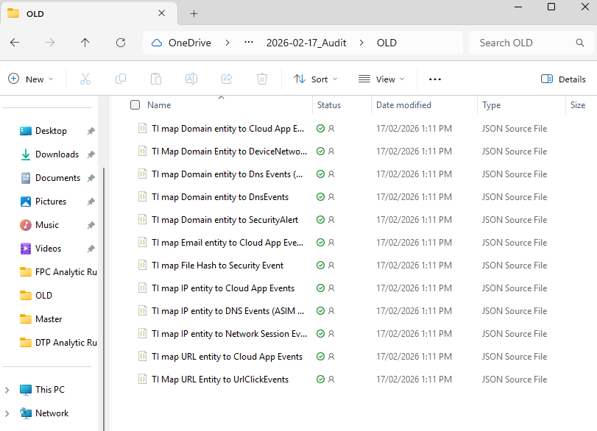
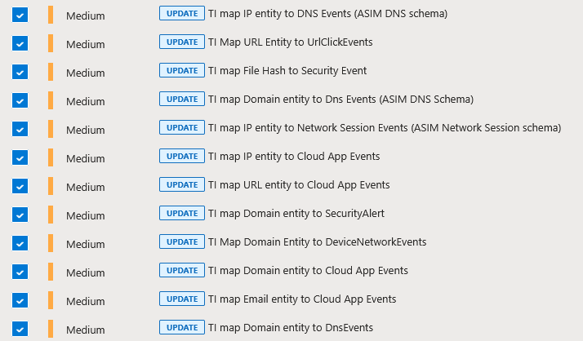
Step 5.1: Understanding Automated Directories – The OLD folder.
Remember Sentinel? When you Enter into the “OLD” folder, You’ll see that the automated program has divided your master JSON file into all the individual rules that you selected from Sentinel!

Slide 8
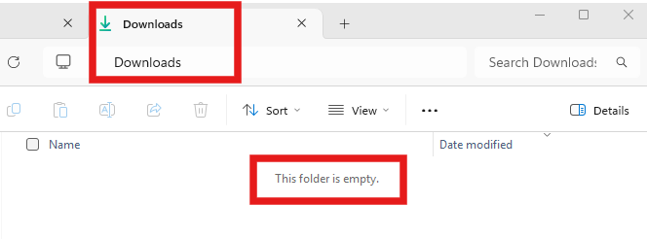
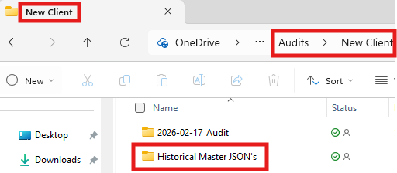
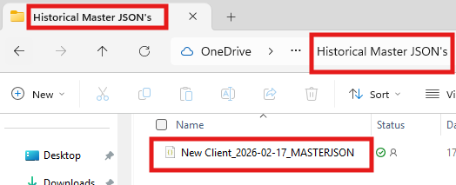
Step 5.2: Understanding Automated Directories – The MASTER JSON file
Now that we have all the individual rules extracted from the master JSON.
What happened to the original file?
The automated program will move the master JSON from the download folder, into a directory that collects all the master files, titled, “Historical Master JSON’s”
Finally, when you enter that folder, you’ll see that the automated program renamed the Master JSON file to a standard format of:
[client name] [date of audit] [MASTERJSON]
This is all automated. You don’t have to worry about it. – Your download folder doesn’t get clogged up, and your auditing file system is automatically updated .

Slide 9
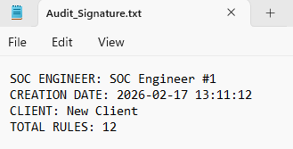
Step 6: Understanding Automated Files – The “Audit_Signature.txt” file
Inside the Audit file, you’ll see a text document titled, “Audit Signature”
This will tell you information about who did this audit, what date, the client and how many rules were audited

Slide 10
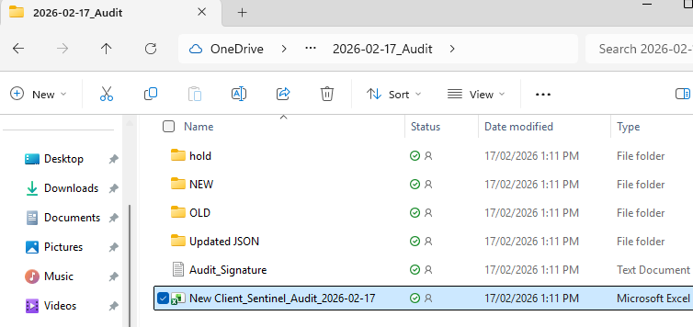
Step 6.1: Understanding Automated Files – The Excel Spreadsheet File.
This is where the real magic happens.
This function saves so much time.
Open the Excel document to view the power of automation!

Slide 11
Step 6.2: Understanding Automated Files – The Excel Spreadsheet File.
The automation tool will create a spread sheet, and import the Rule Name, Current Version, Verify if its Enable/Disabled and extract the Current Rule into the “Old KQL” column.
Just for this demonstration I’ve only shown a small part of what else is included in the generated spread sheet. Continue to the next page to see more!

Slide 12
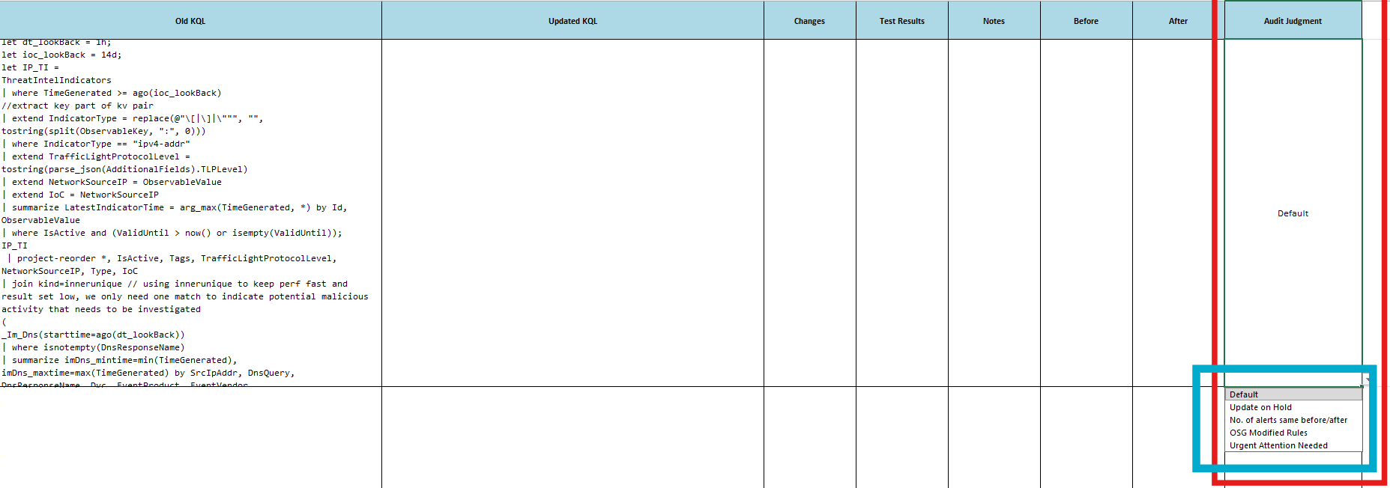
Step 6.3: Understanding Automated Files – The Excel Spreadsheet File.
This is what the other columns look like in the generated spreadsheet. Notice how there is a column for ‘Audit Judgement’. There is a drop-down menu that allows you to select a category for future reference.
If you open the excel document, you will see that there will be a row representing every Rule that you selected in Sentinel.

